Slide 1
Atmospheric Inversion results
Philippe Peylin
LSCE, France
Rachel Law
CSIRO, Australia
Kevin Gurney, Xia Zhang
Arizona State University/Purdue University, USA
Zegbeu poussi
LSCE, France
and model participants

Slide 2
Tutorial 1 : Logistics
1 of these is previous T3 average
These exclude some submissions that were too short
Results accessible at: http://transcom.lsce.ipsl.fr
  Plotted maps and time series (“component” fluxes X aggregated regions) – no psswrd
  Data files (“component” fluxes X aggregated regions and gridded) - psswrd
11 “state of the art” inversions (some multiple submissions)
All re-gridded to a common grid (1°x1°, monthly)
“Component” fluxes = prior, fossil fuel, posterior (estimate)
“Regional” fluxes = land/ocean regions + various aggregates (109)
Region “mask” – boundaries of the chosen regional breakdown and aggregates (regular and extended)
We urge regional leads to contact “inverters” for additional clarification
The complete 1°x1°, monthly files are also available – “roll” your own regions
“transcom”

Slide 3
Tutorial 2 : Participants
Name | Time period | Transport model | Winds | Atm Data | Flux spatial res. | Flux temp. Res. | Inverse Method
Lsce_an_v2.1 | 1996 - 2004 | LMDZ v4 | ECMWF | Monthly mean | gridcell | monthly | Bayesian Matrix
Lsce_var_v1.0 | 1990- 2008 | LMDZ v3 | ECMWF | Raw | gridcell | 8 day with night & day sep | Variational
Jena_s96_v3.2 | 1996 - 2008 | TM3 | NCEP reanalysis | Raw | gridcell | Daily | Variational
Carbntrckr_US | 2000 - 2008 | TM5 zoom |  | Raw | 156 ecoregions | weekly | Kalman smoother
Carbntrckr_EU | 2000 - 2007 | TM5 zoom |  | Raw | 145 land + 30 ocean | weekly | Kalman smoother
Rigc_patra | 1993 - 2007 | NIES/FRCGC | NCEP reanalysis | Monthly mean | 64 | Monthly | Bayesian Matrix
T3 mean | 1995 - 2008 | 13 models | 13 models (climatology) | Monthly mean | 22 | Monthly | Bayesian Matrix
JMA | 1985 - 2007 |  |  | Monthly mean | 22 | Monthly | Bayesian Matrix
Nicam_Niwa |  | NICAM-TM |  | Monthly mean | 22 | Monthly | Bayesian Matrix
C13_MATCHRayner | 1992 - 2005 | MATCH | NCEP 1999 (climatology) | Monthly mean | 116 | Monthly | Bayesian Matrix
C13_CCAM Law | 1992 - 2005 | CCAM | NCEP 1999 (climatology) | Monthly mean | 146 | Monthly | Bayesian Matrix
We are choosing a start date of 1995 for RECCAP

Slide 4

Tutorial 3: Miscellaneous notes
Fossil emissions differed between inversions:
Attempted “fix”: Fossil “adjustment” with common fossil fuel CO₂ flux
Uncertainties: (in progress, Enting et al., Transcom)
  “Bayesian” errors will be provided for key regions
  Spread induced by changing model components available for few cases (contact individual modeler)
“Validation” against independent data (in progress)
  Atm. Vertical profile, campaign, independent C-cycle obs, etc
  Regridding & land/sea mask can create inaccuracies
  ➔ special care for regions with shaped coastal boundaries

Slide 5
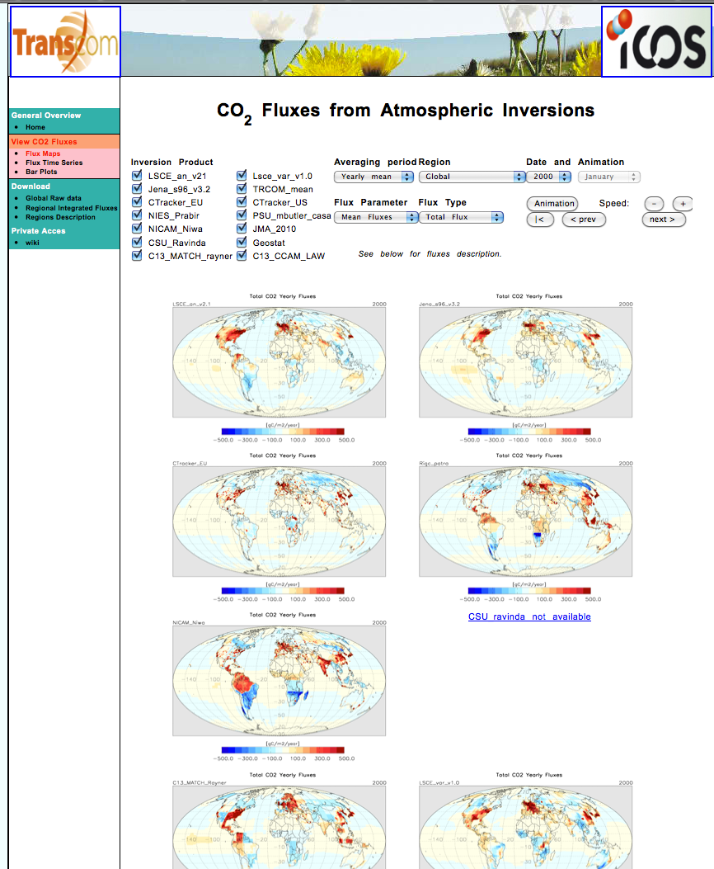
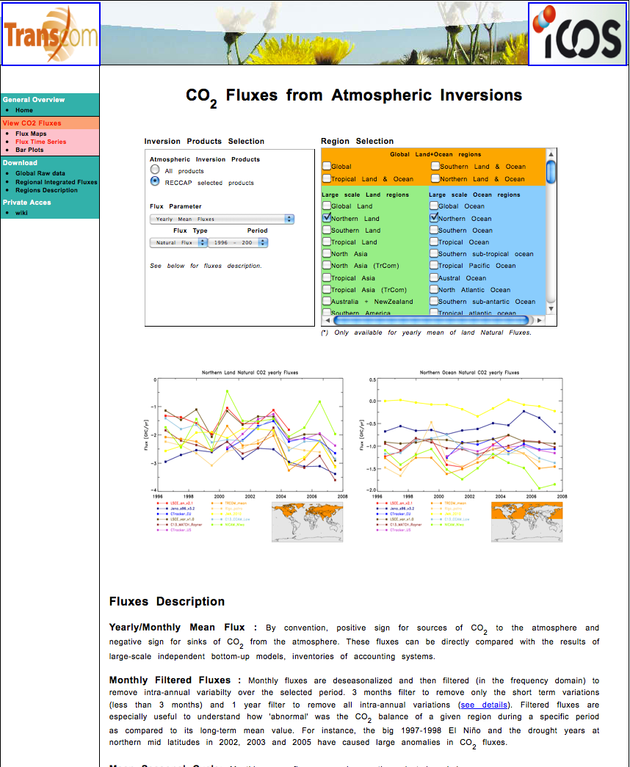
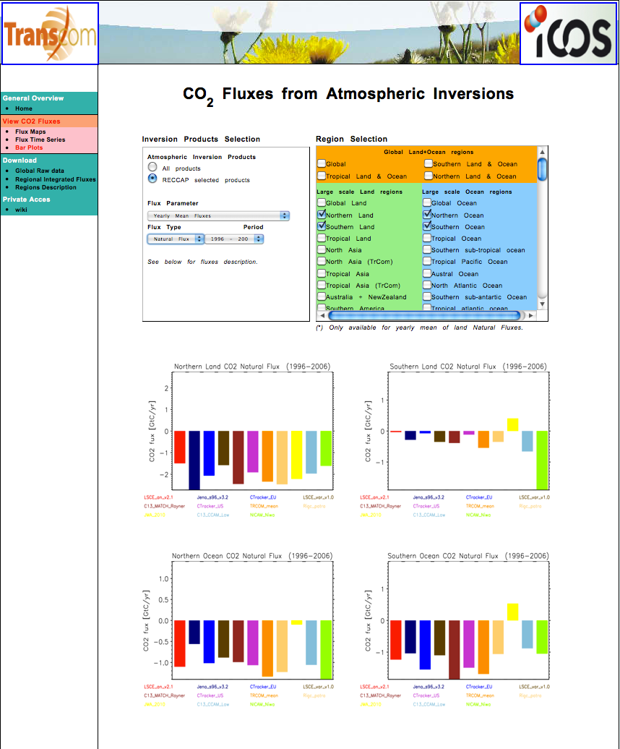
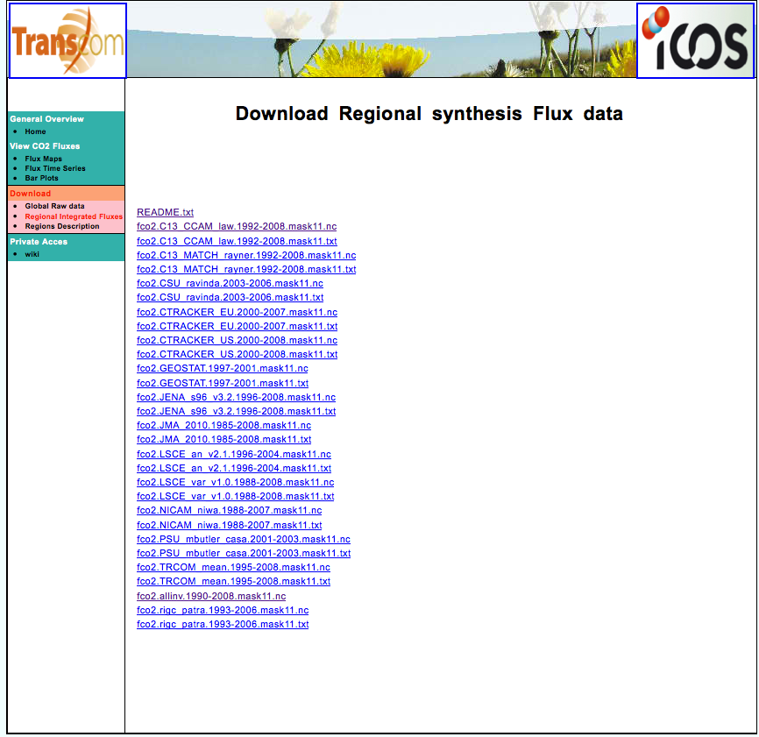
Website
Thank you Zegbeu!

Slide 6
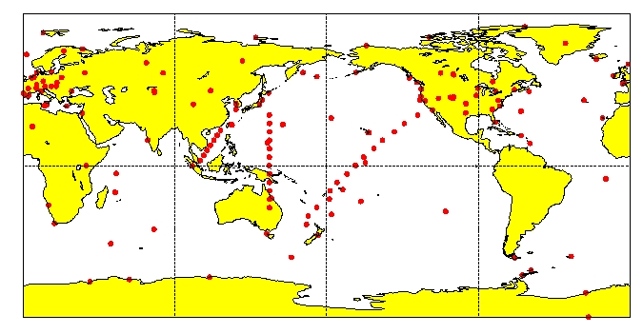
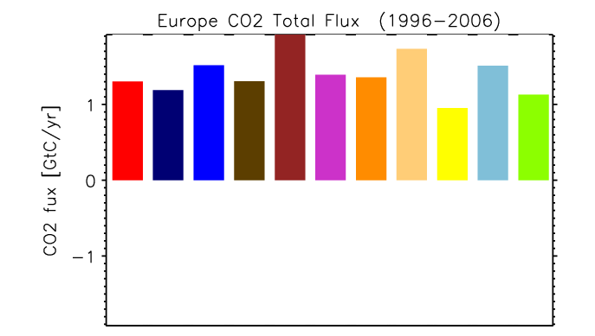
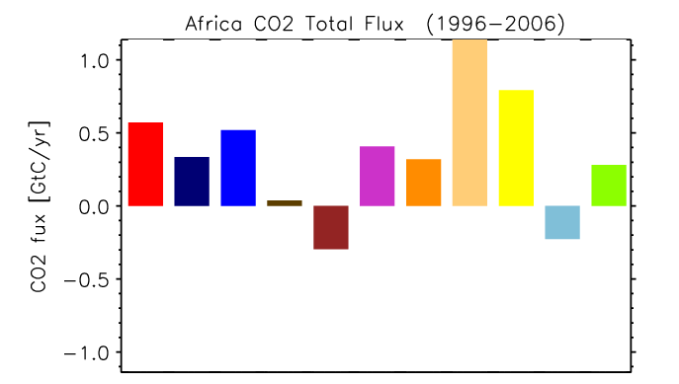
Tutorial 4: Proceed with Caution
Well-constrained region (Europe)
Poorly-constrained region (Africa)

Slide 7
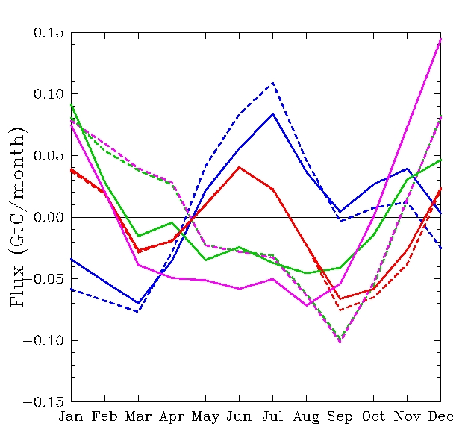
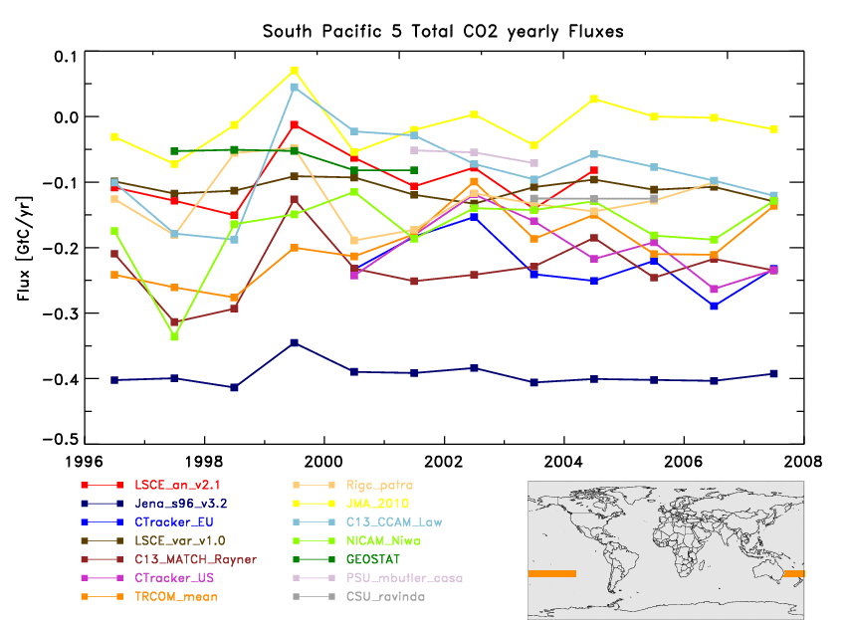
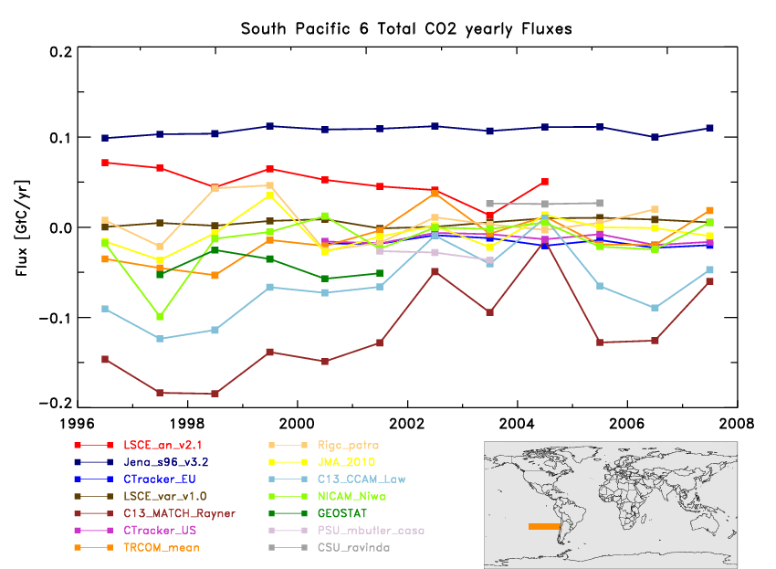
4 continued: Consequences of poor constraints
Influence of prior
Sensitivity to an individual site
Jena (dark blue) only inversion without EIC and very different E-W flux split
Australian seasonal cycle from 4 inversions. Posterior (solid), prior (dashed).
Different prior seasonality due to inclusion or not of biomass burning.

Slide 8
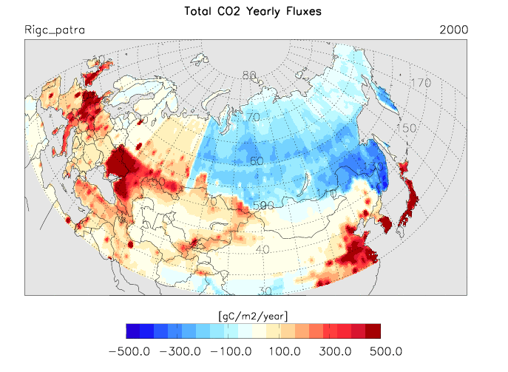
4 continued: Caution with “big region” estimates
Annual total flux (GtC/yr)
North Asia
EUROPE
➔“spurious” anti-correlations – a
form of “representation error”
Large flux dipoles : « regional estimates should be interpreted
with great care depending on the boundary of the regions

Slide 9
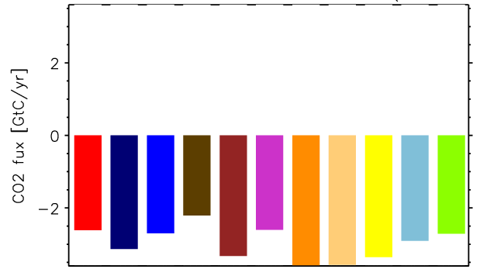
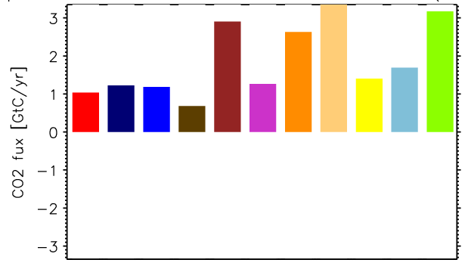
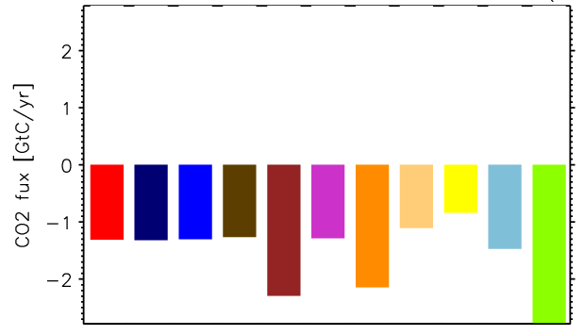
Results 1 : Long term means
Natural fluxes (GtC/yr) – 2000-2003 period
Northern land + ocean
Tropical land + ocean
LSCE_an_v2.1
JENA_s96_v3.2
CTracker_EU
LSCE_var_v1.
C13_MATCH
CTracker_US
TRCOM_me
RIGC_patra
JMA_2010
C13_CCAM
NCAM_Niwa
Southern land + ocean

Slide 10
The following results are preliminary and based on current submissions. These may change at a future time.

Slide 11
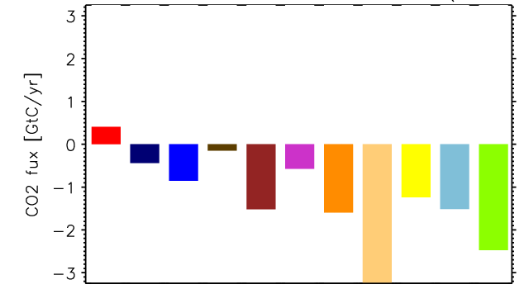
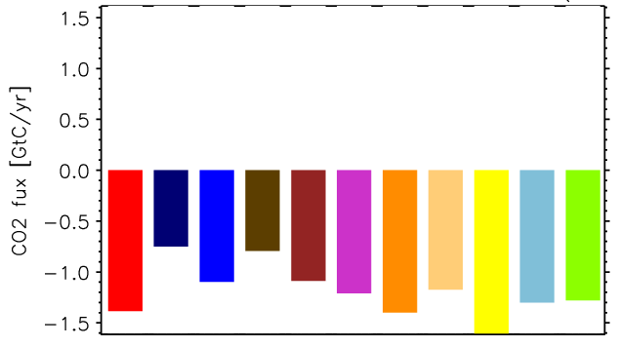
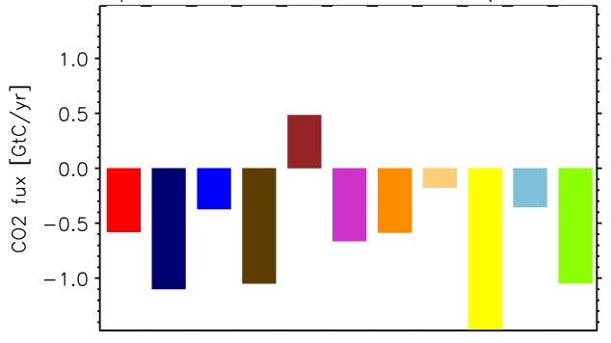
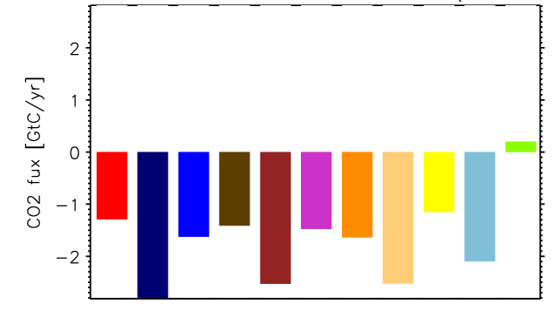
Results 1 : Long term means
Natural fluxes (GtC/yr) – 2000-2003 period
N. America
N. Atlantic
LSCE_an_v2.1
JENA_s96_v3.2
CTracker_EU
LSCE_var_v1.
C13_MATCH
CTracker_US
TRCOM_me
RIGC_patra
JMA_2010
C13_CCAM
NCAM_Niwa
Europe
N. Asia

Slide 12
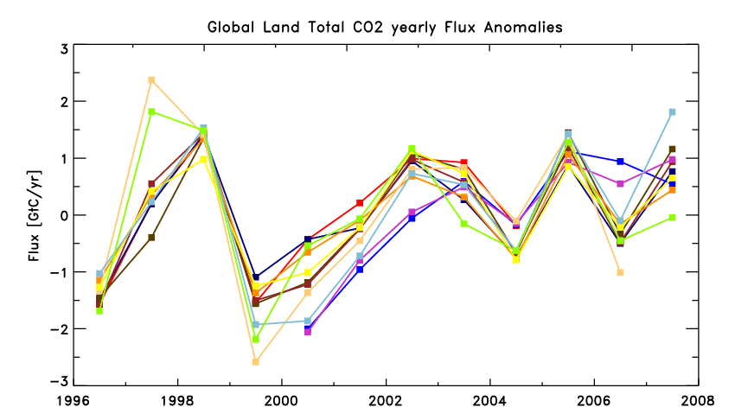
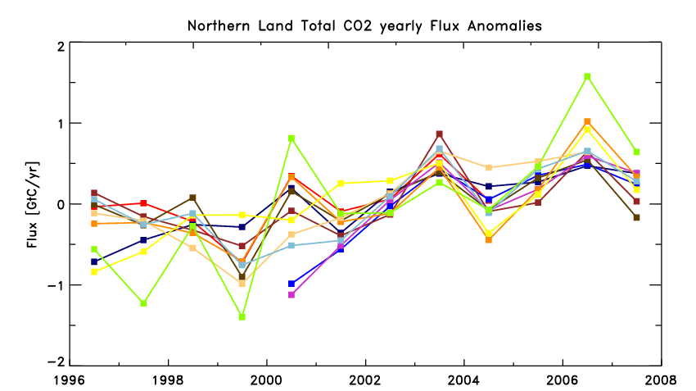
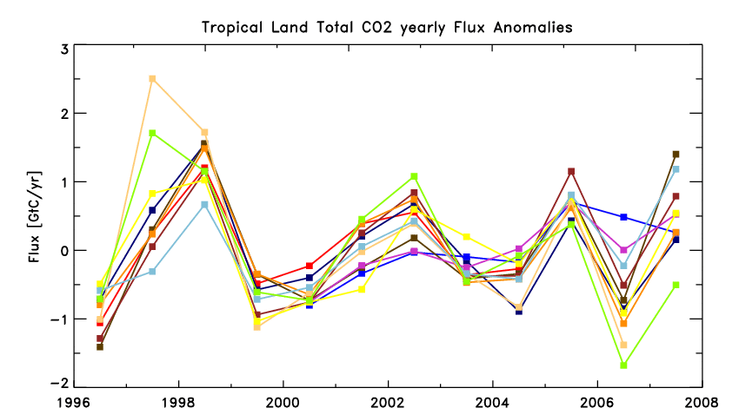
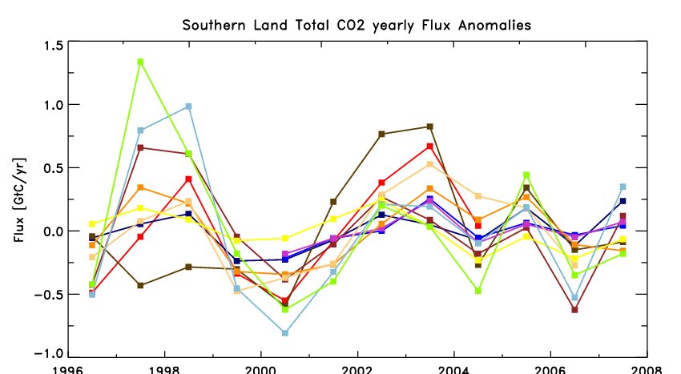
Results 2: IAV (land)
LSCE_an_v2.1
JENA_s96_v3.2
CTracker_EU
LSCE_var_v1.
C13_MATCH
CTracker_US
TRCOM_me
RIGC_patra
JMA_2010
C13_CCAM
NCAM_Niwa
Total land
Northern land
Tropical land
Southern land

Slide 13
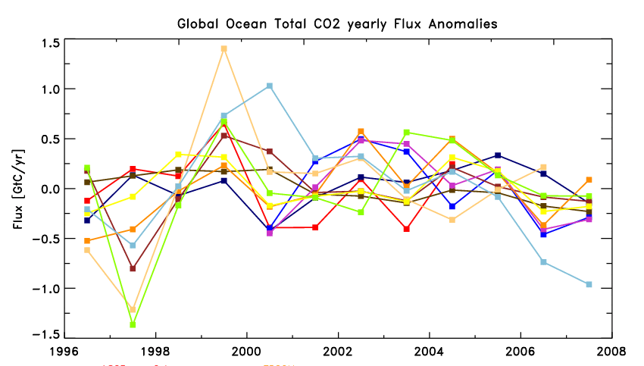
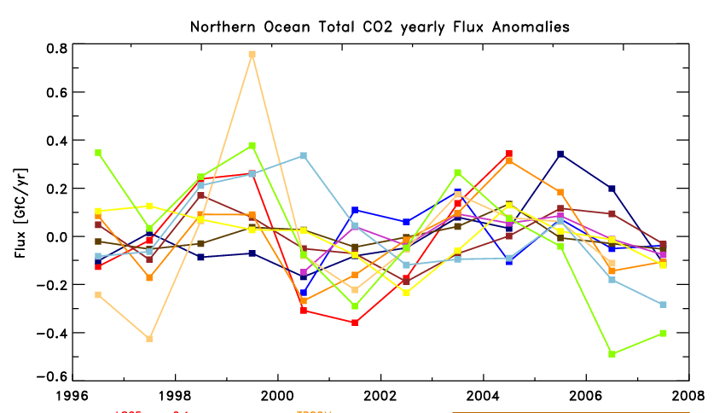
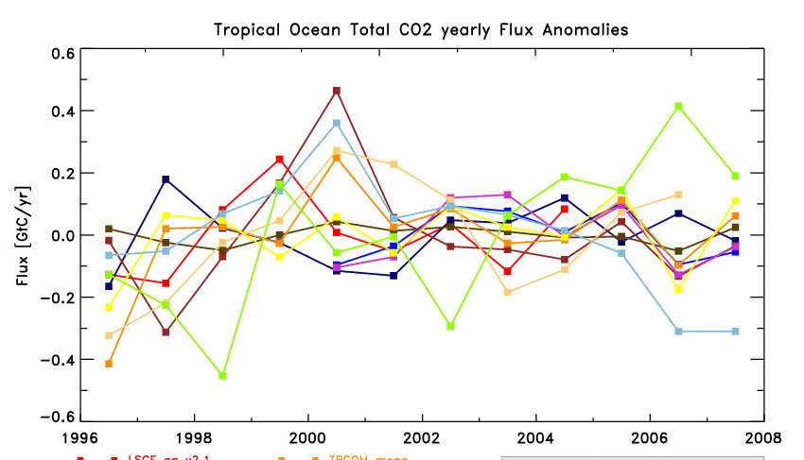
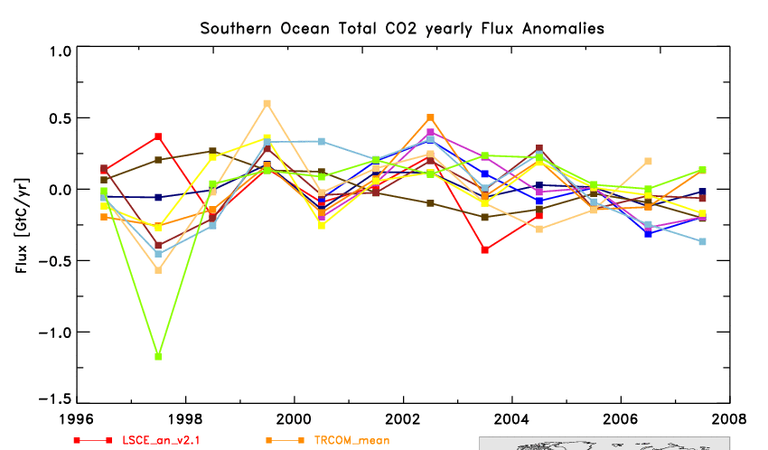
Results 2: IAV (ocean)
LSCE_an_v2.1
JENA_s96_v3.2
CTracker_EU
LSCE_var_v1.
C13_MATCH
CTracker_US
TRCOM_me
RIGC_patra
JMA_2010
C13_CCAM
NCAM_Niwa
Total ocean
Northern ocean
Tropical ocean
Southern ocean

Slide 14
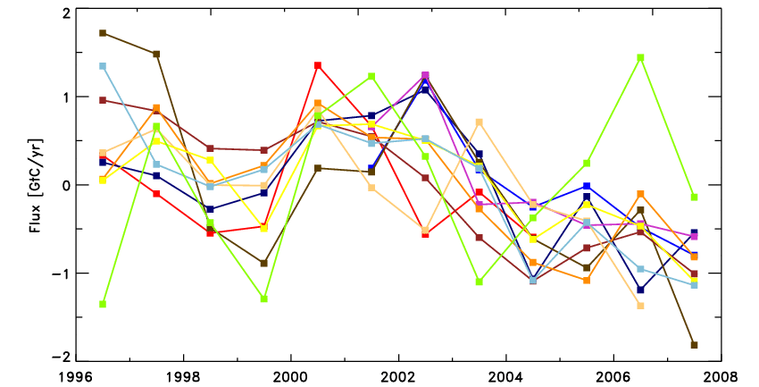
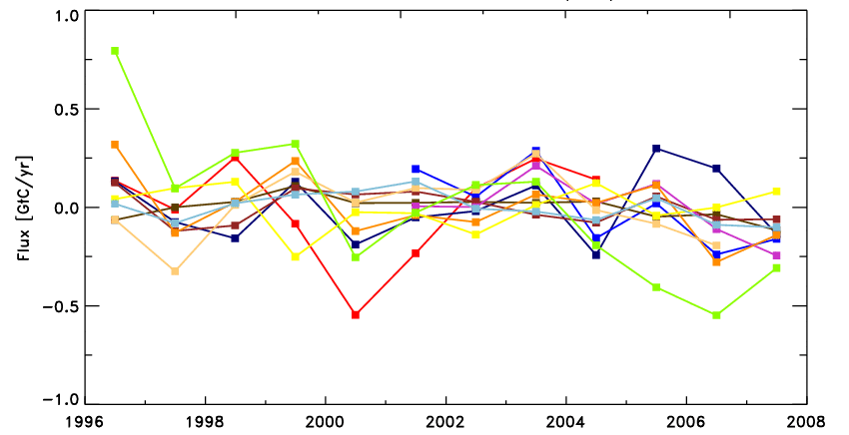
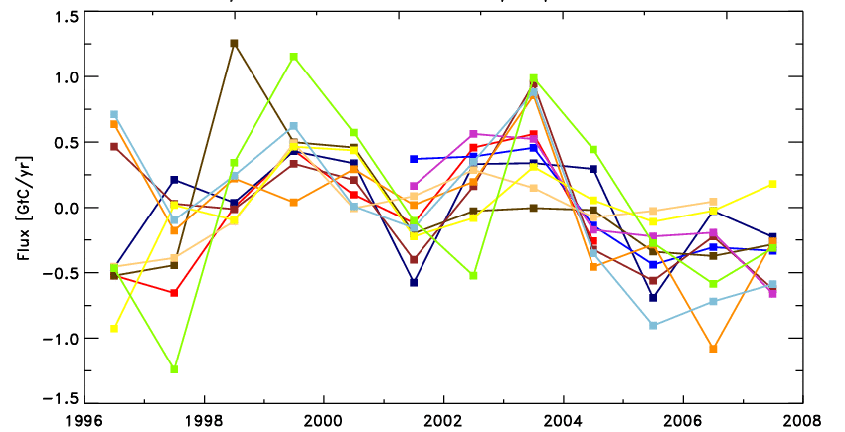
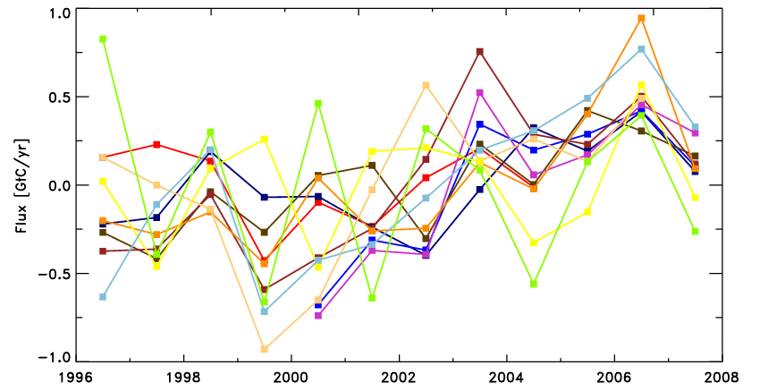
Results 2: IAV (continental scale)
N. America
N. Atlantic
LSCE_an_v2.1
JENA_s96_v3.2
CTracker_EU
LSCE_var_v1.
C13_MATCH
CTracker_US
TRCOM_me
RIGC_patra
JMA_2010
C13_CCAM
NCAM_Niwa
Europe
N. Asia

Slide 15
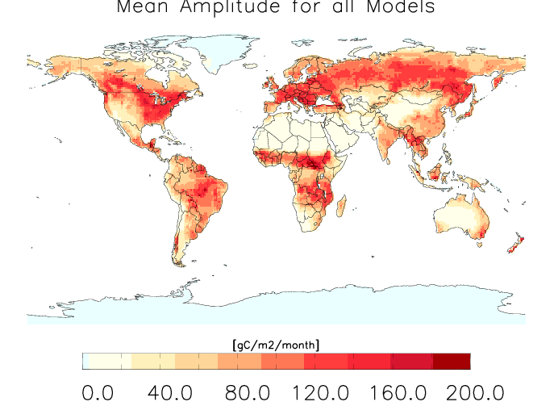
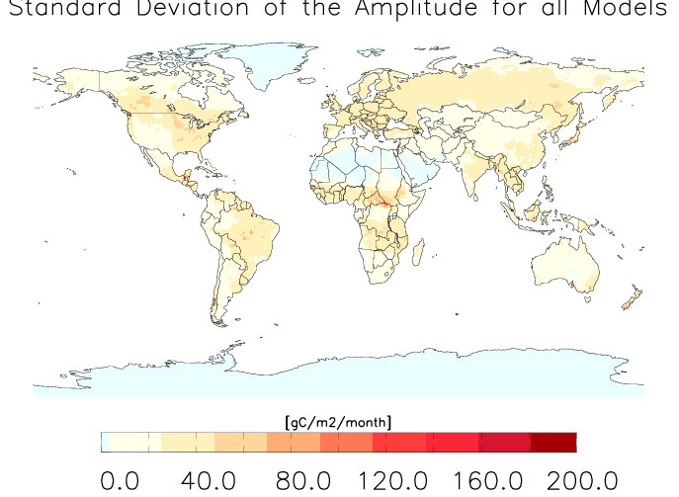
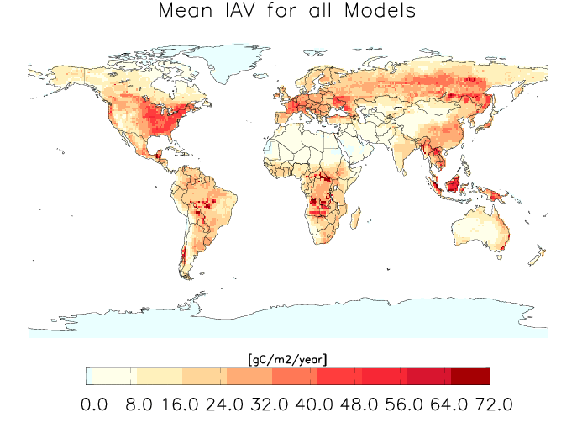
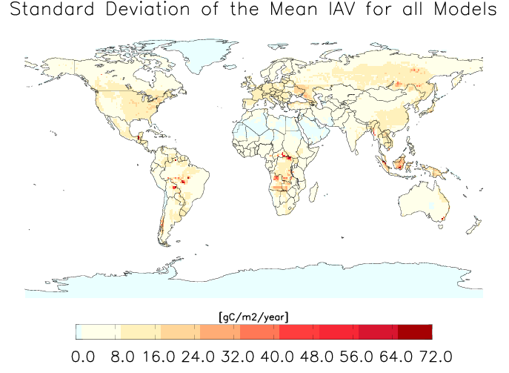
Results 3 : Seas. Cycle & IAV
Seas.
Cycle
Mean amplitude of all models
Standard dev. of all models
IAV
Mean IAV for all models
Standard dev. of all models

Slide 16
Results 4 : N-S zonal mean integrated fluxes

Slide 17
Summary
New set of 11 inverse results (which includes TRcom3 mean as 1)
WEB-site available for downloading
Uncertainties & Validation in progress (part of Transcom)
Results may be updated with announcement
Proceed with caution together with “inverse” specialists
Differences in long term mean but coherence in IAV
at large scales
Small scales regional results sensitive to:
Network, Priors, Flux resolution…

Slide 18
Thank You

Slide 19
Global Inversion Status/Plans
Results accessible at: http://transcom.lsce.ipsl.fr
11 results available at 1°x1° & region (individual and aggregate: 109)
1995 to 2008 (inc) but individuals will run back to 1980 – monthly/annual
Fluxes include: prior, fossil, posterior, total, “adjusted” fluxes
Region “mask” and explanation available
Updates will occur (we will announce)
Uncertainty work & decisions ongoing
Decision on a “weighted” mean ongoing
Proceed with caution (tentative “inverter” assignments made for ocean)
TransCom meeting: December San Francisco AGU

