Slide 1
DGVM runs for Trendy/RECCAP
S. Sitch, P. Friedlingstein, A. Ahlström, A. Arneth, G. Bonan, P. Canadell, F. Chevallier, P. Ciais, C. Huntingford, C. D., P. Levy, M. R. Lomas, B. Mueller, M. Reichstein, S. Running, S. I. Seneviratne, N. Viovy, F. I. Woodward, S. Zaehle, M. Zhao

Slide 2
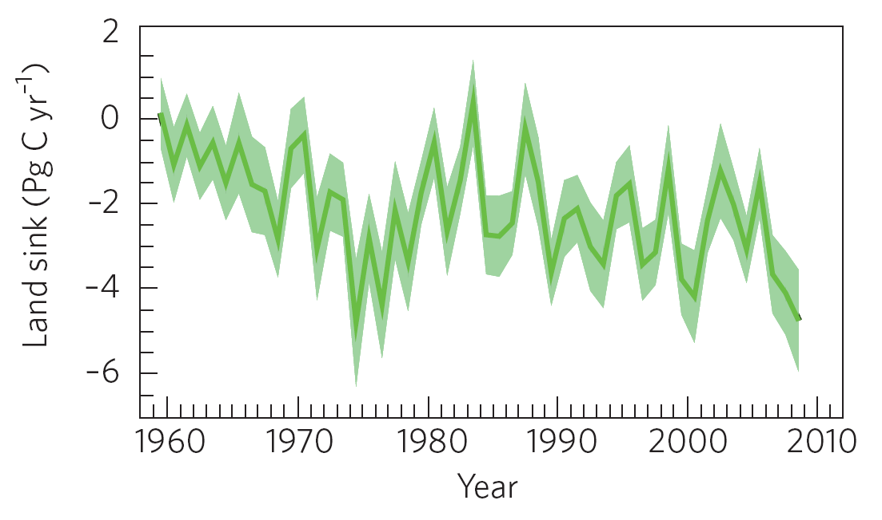
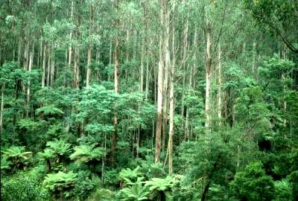
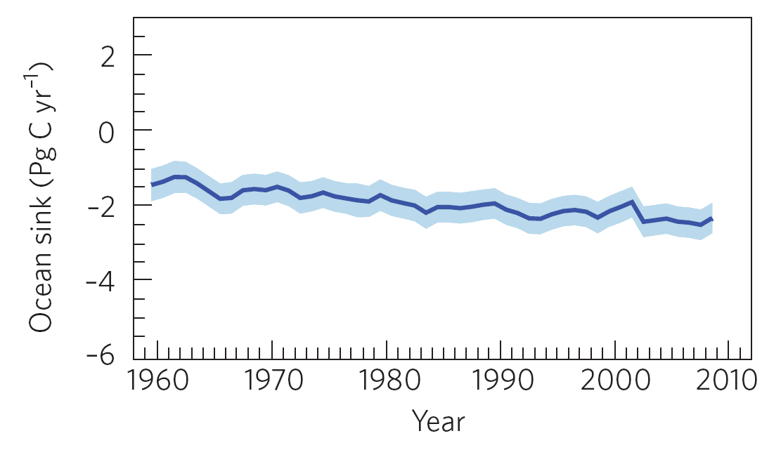

Modelled Natural CO₂ Sinks
Le Quéré et al. 2009, Nature-geoscience
Notes:
Terrestrial CO2 sinks removed 29% of all anthropogenic emissions for the period 2000-2008, equivalent to an average of 3 PgC per year. In 2008, terrestrial ecosystems removed 4.7 PgC, significantly higher than the long term average owing to the wetter conditions brought about by La Niña. An analysis of the long term trend of the terrestrial sink shows a growing size of the CO2 sink over the last 60 years but not discernable change in the efficiency of the sink
The terrestrial sink was estimated using an ensemble of 5 global vegetation models forced by observed CO2 concentration and a combination of meteorological data from the Climatic Research Unit and US National Centers for Environmental Prediction.

Slide 3
Regional Trends in C-sinks and Annual Global Budget
Global Annual Budget
Regional Trends in Land C-Sinks (Trendy)
Compare DGVM-based estimates with other evidence
  - Satellite derived data
  - Fluxtower data
  - Atmospheric Monitoring Stations

Slide 4
Trendy Protocol
GCP- Land trends: modelling protocol
Contact: Stephen Sitch (s.sitch@leeds.ac.uk) & Pierre Friedlingstein (p.friedlingstein@exeter.ac.uk) http://dgvm.ceh.ac.uk
Goal: To investigate the trends in NEE over the period 1980-2009
Participating models
JULES, LPJ, LPJ-GUESS, O-CN, Orchidee, HyLand, SDGVM, NCAR-CLM4,
GFDL/Princeton, VEGAS
Model simulations
The models were forced over the 1901-2009 period with changing CO₂, climate (CRU/NCEP) and land use:
S1: CO2 only
S2: CO2 and climate
S3 (optional): CO2, climate and land use

Slide 5
Trends in Land Processes
Land Sink trend
positive NPP trend > positive RESP trend
negative NPP trend > negative RESP trend
positive NPP trend, negative RESP trend
Land Source trend
positive NPP trend < positive RESP trend
negative NPP trend < negative RESP trend
negative NPP trend, positive RESP trend
Notes:
categories
Land Sink trend
positive NPP trend > positive RESP trend (value 1.5)
negative NPP trend > negative RESP trend (value 2.5)
positive NPP trend, negative RESP trend (value 3.5)
Land Source trend
positive NPP trend < positive RESP trend (value 4.5)
negative NPP trend < negative RESP trend (value 5.5)
negative NPP trend, positive RESP trend (value 6.5)

Slide 6
Climatic Drivers of Trends in Land Processes
Land Sink trend
positive NPP trend > positive RESP trend
negative NPP trend > negative RESP trend
positive NPP trend, negative RESP trend
Land Source trend
positive NPP trend < positive RESP trend
negative NPP trend < negative RESP trend
negative NPP trend, positive RESP trend

Slide 7
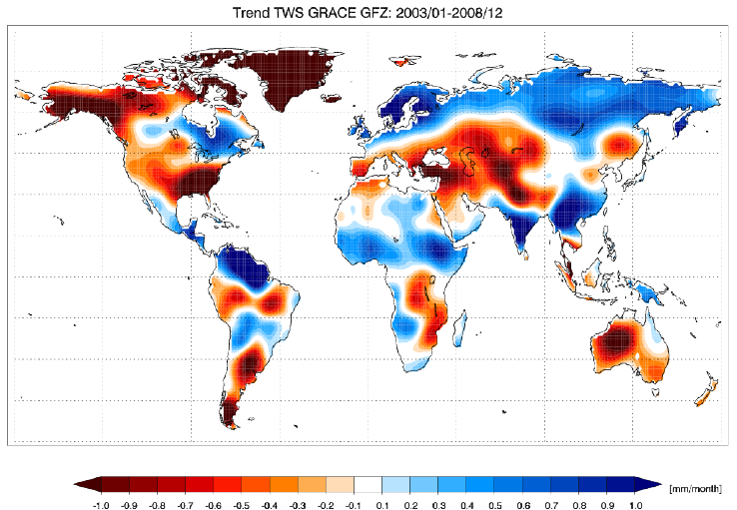
Satellite Evidence: Trends in Soil Moisture
B. Mueller, ETH Zurich

Slide 8
Remarkable Similarity between NPP evolution from DGVMs

Slide 9
Global NPP explains most of the NEE variability

Slide 10
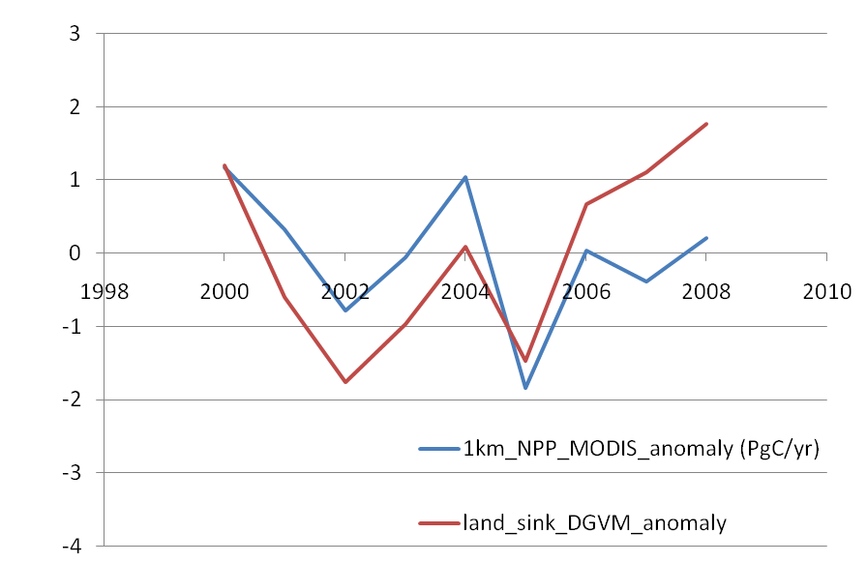
DGVM sink vs MODIS-NPP
M Zhao

Slide 11
Alternative Upscaling Approaches Multidimensional flux patterns...
century
forest
inventory
plot
Forest/soil inventories
decade
Landsurface remote sensing
Eddy
covariance
towers
tall
tower
obser-
vatories
Color: GPP
year
remote sensing
of CO₂
Temporal scale
month
week
day
hour
local 0.1 1 10 100 1000 10 000 global
plot/site
Countries
EU
Spatial scale [km]
... models to be cross-evaluated against.
Reichstein

Slide 12
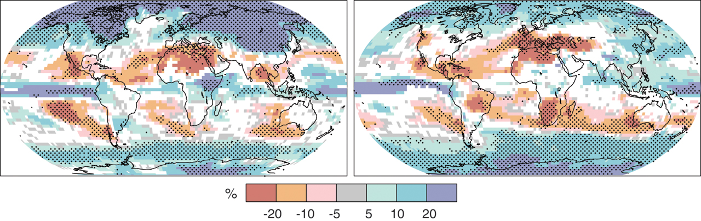
Future Precipitation Changes (Summer Droughts?)
JJA
http://www.ipcc.ch/
Stippled areas > 90% of the models agree in the sign of the change
Notes:
Figure SPM.7. Relative changes in precipitation (in percent) for the period 2090–2099, relative to 1980–1999. Values are multi-model averages based on the SRES A1B scenario for December to February (left) and June to August (right). White areas are where less than 66% of the models agree in the sign of the change and stippled areas are where more than 90% of the models agree in the sign of the change. {Figure 10.9}

Slide 13
Summary
Use set-up to produce global/regional annual C-budgets
Drought may be an important driver of the present-day trends in the land carbon cycle
Climate Models Project Summer Drought in Continental Regions
Drought may be an important driver of the future trends in the land carbon cycle
Critical to understand Ecosystem Response to Drought for future Earth System feedbacks

